Slide 1
Dynamic Programming in AI
From DTW to Fast DTW
Poerwiyanto
Data Scientist
Accenture Applied Intelligence Indonesia

Slide 2
About ACCENTURE

Slide 3

Accenture is a global professional services company with leading capabilities in digital, cloud and security
Our purpose
To deliver on the promise of technology and human ingenuity

Slide 4

We provide a broad range of services at scale- from strategy to operations.
Strategy & Consulting
Strategies to Accelerate Digital Transformation
Enhancing Growth / Profitability to Deliver Sustainable Value
Deep Industry / Functional Expertise
Applied Intelligence
Innovation Hubs
Connected Products / Platforms
Interactive
Meaningful Experiences to Drive Growth and Value
Growth, Product & Culture Design
Technology & Experience Platforms
Creative, Media & Marketing Strategy
Campaign, Content & Channel Orchestration
Technology
Cloud
Systems Integration / Application Management
Security
Intelligent Platform Services
Infrastructure
Software Engineering
Labs / Ventures
Ecosystem Alliances
Operations
Business Process Services
Function-Specific
Finance & Accounting / Procurement / Supply Chain / Marketing
Industry-Specific
Banking / Insurance / Health Care
INDUSTRY-SPECIFIC SOLUTIONS
Notes:
Ensure the titles are not duplicated. Please check the set of best practices.

Slide 5

Accenture Semarang

Slide 6
Recruitment matters
Graduate career portals:
https://www.accenture.com/id-en/careers
https://www.accenture.com/id-en/careers/life-at-accenture/entry-level
https://www.accenture.com/id-en/careers/life-at-accenture/internships-careers
Campus recruiter (based in Jakarta):
Nada R Lusarda – nada.r.lusarda@accenture.com
ATC Semarang Recruiter (based in Philippine):
Gelo Alejandro - michael.a.alejandro@accenture.com

Slide 7

About Speaker
Poerwiyanto
5 years of experience in natural language understanding and time series forecasting. Has involved in several projects, notably conversational bot and intelligent data quality management for one of the largest telecommunication company in Indonesia
Accenture Career
Joined Accenture as Business & Integration Arch. Analyst in May 2017
Data Scientist at Applied Intelligence Indonesia since 2020
Education
Universitas Gadjah Mada – Master of Computer Science (M.Cs.)
Universitas Gadjah Mada – Sarjana Ilmu Komputer (S.Kom.)

Slide 8
Introduction to Dynamic Programming
Solving Fibonacci Numbers

Slide 9
Dynamic Programming (DP)
Introduction
A technique for solving problems with overlapping subproblems, breaking down a problem into simpler subproblems
Utilizing the fact that the solution of the overall problem depends upon the solutions to its smaller subproblems
Rather than solving overlapping subproblems again and again, DP suggests solving each of the smaller subproblems only once and recording the results which can then be used to solve the overall problem

Slide 10
Fibonacci Numbers
Overview
A series of numbers in which each number is the sum of the two preceding numbers
The first 10 Fibonacci numbers
0, 1, 1, 2, 3, 5, 8, 13, 21, 34, ...
Can be defined by simple recurrence
F(n) = F(n – 1) + F(n – 2) for n > 1
with F(0) = 0 and F(1) = 1

Slide 11
Fibonacci Numbers
Overlapping Subproblems
Fib (4)
Fib (3)
Fib (2)
Fib (2)
Fib (1)
Fib (1)
Fib (0)
Fib (1)
Fib (0)

Slide 12
Fibonacci Numbers
Three Approaches in Solving Fibonacci Numbers
Non DP or recursive Runs in O(2^{N}) or exponential
DP with memoization Runs in O(N) or linear if done right
DP with tabulation Runs in O(N) or linear

Slide 13
Dynamic Time Warping
😒: Using python library?
🤓: No, from scratch
😒: Promise?
🤓: Yes, for real!

Slide 14
Time Series is Almost Everywhere!
Web Clicks
Wearables
Speech Recognition
Sensor Data
Financial Market

Slide 15
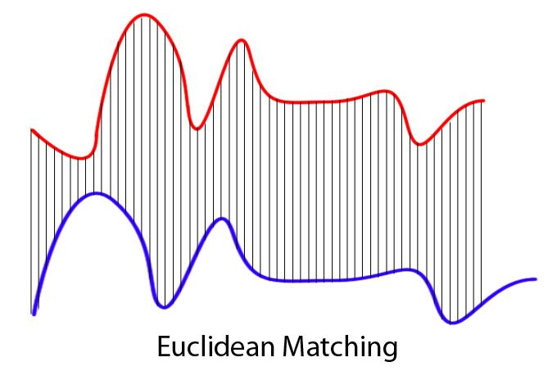
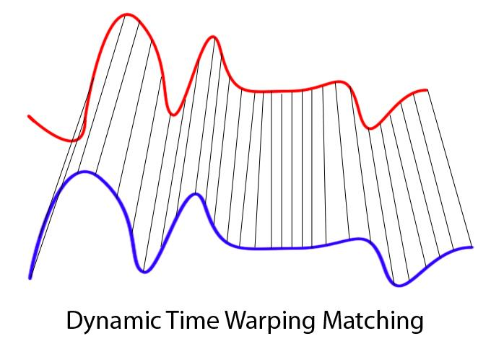
Dynamic Time Warping (DTW)
Motivation
Calculate the distance between two time series, even with different lengths
Identify which points correspond to one another

Slide 16
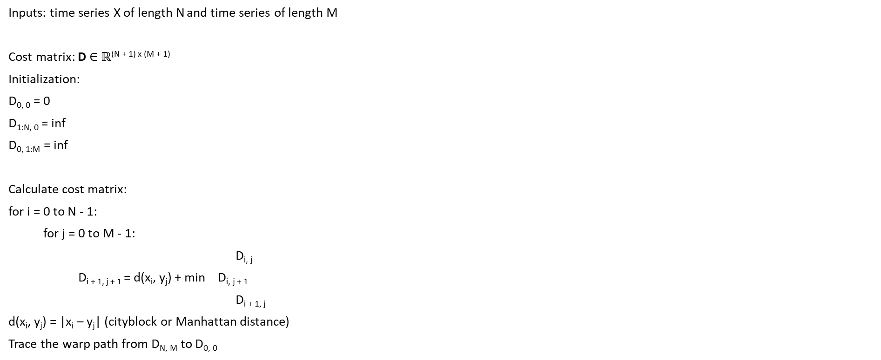
Dynamic Time Warping (DTW)
Algorithm
Inputs: time series X of length N and time series of length M
Cost matrix: D $∈$ $ℝ$^{(N + 1) x (M + 1)}
Initialization:
D_{0, 0} = 0
D_{1:N, 0} = inf
D_{0, 1:M} = inf
Calculate cost matrix:
for i = 0 to N - 1:
for j = 0 to M - 1:
D_{i, j}
D_{i + 1, j + 1} = d(x_{i}, y_{j}) + min D_{i, j + 1}
D_{i + 1, j}
d(x_{i}, y_{j}) = |x_{i} – y_{j}| (cityblock or Manhattan distance)
Trace the warp path from D_{N, M} to D_{0, 0}

Slide 17
Dynamic Time Warping (DTW)
Example
Inputs: time series X of length N and time series of length M
Cost matrix: D $∈$ $ℝ$^{(N + 1) x (M + 1)}
Initialization:
D_{0, 0} = 0
D_{1:N, 0} = inf
D_{0, 1:M} = inf
Calculate cost matrix:
for i = 0 to N - 1:
for j = 0 to M - 1:
D_{i, j}
D_{i + 1, j + 1} = d(x_{i}, y_{j}) + min D_{i, j + 1}
D_{i + 1, j}
d(x_{i}, y_{j}) = |x_{i} – y_{j}| (cityblock or Manhattan distance)
Trace the warp path from D_{N, M} to D_{0, 0}
Time Series Y
 | 0 | 1 | 2 | 3 | 4 | 5 | 6 | 7
0 | 0 | inf | inf | inf | inf | inf | inf | inf
1 | inf
2 | inf
3 | inf
4 | inf
5 | inf
6 | inf
Time Series X

Slide 18
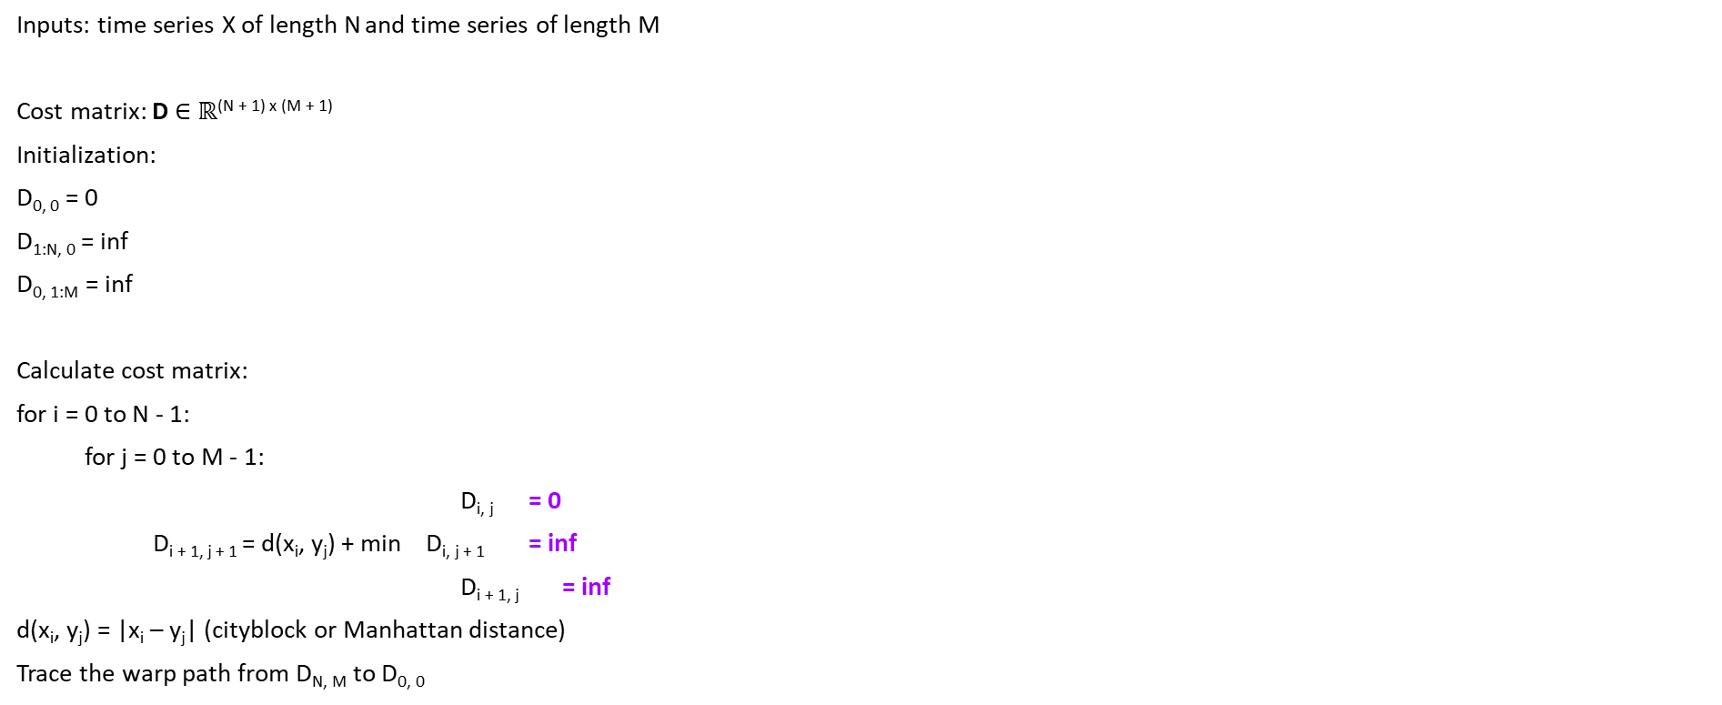
Dynamic Time Warping (DTW)
Example
Inputs: time series X of length N and time series of length M
Cost matrix: D $∈$ $ℝ$^{(N + 1) x (M + 1)}
Initialization:
D_{0, 0} = 0
D_{1:N, 0} = inf
D_{0, 1:M} = inf
Calculate cost matrix:
for i = 0 to N - 1:
for j = 0 to M - 1:
D_{i, j} = 0
D_{i + 1, j + 1} = d(x_{i}, y_{j}) + min D_{i, j + 1} = inf
D_{i + 1, j} = inf
d(x_{i}, y_{j}) = |x_{i} – y_{j}| (cityblock or Manhattan distance)
Trace the warp path from D_{N, M} to D_{0, 0}
Time Series Y
 | 0 | 1 | 2 | 3 | 4 | 5 | 6 | 7
0 | 0 | inf | inf | inf | inf | inf | inf | inf
1 | inf | 0
2 | inf
3 | inf
4 | inf
5 | inf
6 | inf
= 0
= 0
Time Series X
= 0

Slide 19
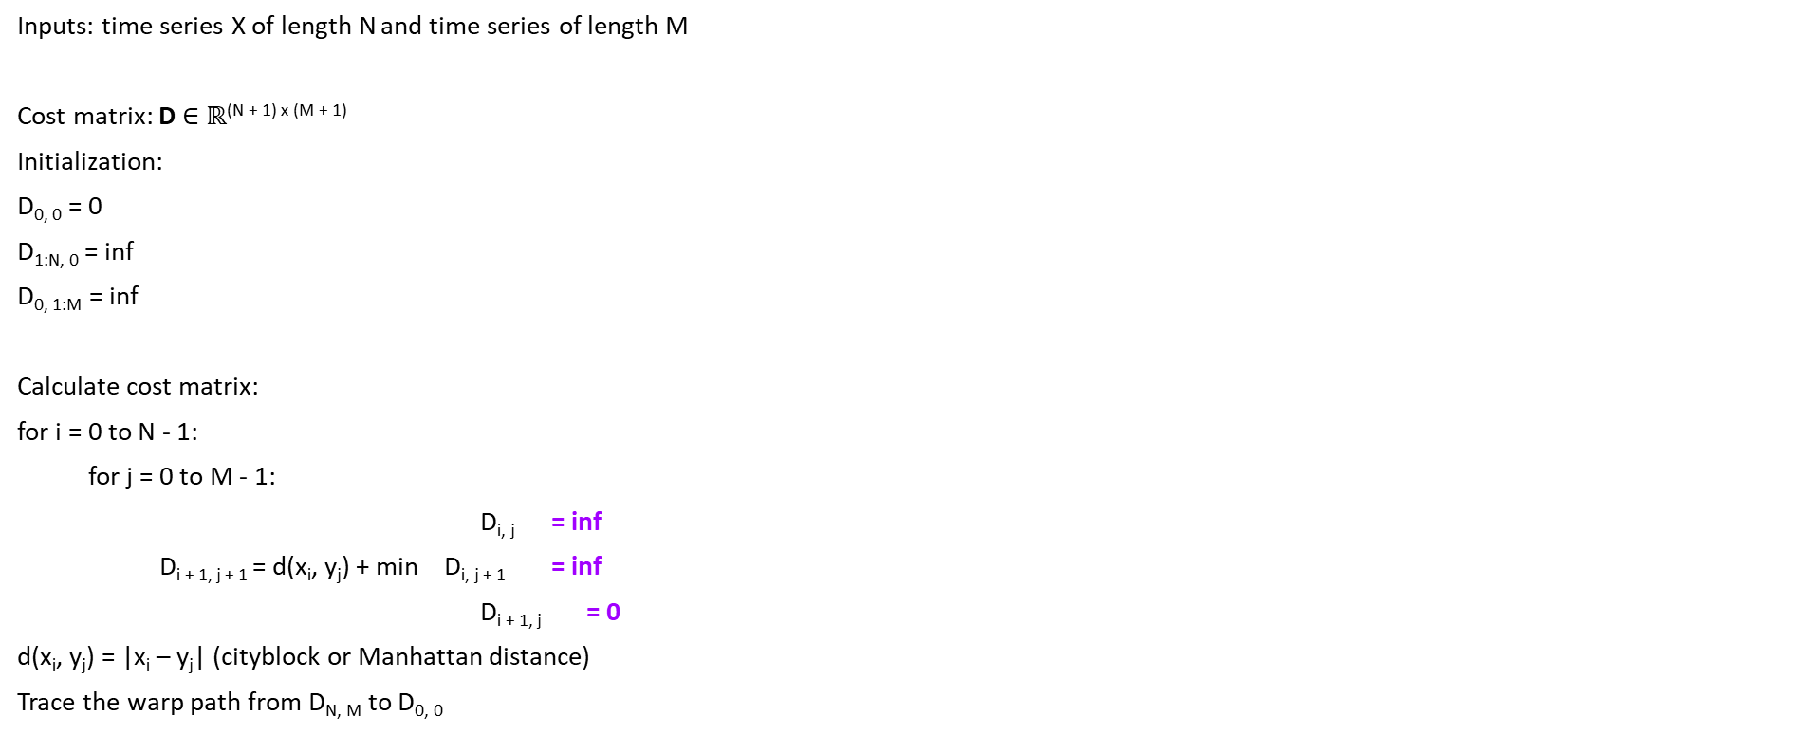
Dynamic Time Warping (DTW)
Example
Inputs: time series X of length N and time series of length M
Cost matrix: D $∈$ $ℝ$^{(N + 1) x (M + 1)}
Initialization:
D_{0, 0} = 0
D_{1:N, 0} = inf
D_{0, 1:M} = inf
Calculate cost matrix:
for i = 0 to N - 1:
for j = 0 to M - 1:
D_{i, j} = inf
D_{i + 1, j + 1} = d(x_{i}, y_{j}) + min D_{i, j + 1} = inf
D_{i + 1, j} = 0
d(x_{i}, y_{j}) = |x_{i} – y_{j}| (cityblock or Manhattan distance)
Trace the warp path from D_{N, M} to D_{0, 0}
Time Series Y
 | 0 | 1 | 2 | 3 | 4 | 5 | 6 | 7
0 | 0 | inf | inf | inf | inf | inf | inf | inf
1 | inf | 0 | 0
2 | inf
3 | inf
4 | inf
5 | inf
6 | inf
= 0
= 1
Time Series X
= 0

Slide 20
Dynamic Time Warping (DTW)
Example
Inputs: time series X of length N and time series of length M
Cost matrix: D $∈$ $ℝ$^{(N + 1) x (M + 1)}
Initialization:
D_{0, 0} = 0
D_{1:N, 0} = inf
D_{0, 1:M} = inf
Calculate cost matrix:
for i = 0 to N - 1:
for j = 0 to M - 1:
D_{i, j} = inf
D_{i + 1, j + 1} = d(x_{i}, y_{j}) + min D_{i, j + 1} = inf
D_{i + 1, j} = 0
d(x_{i}, y_{j}) = |x_{i} – y_{j}| (cityblock or Manhattan distance)
Trace the warp path from D_{N, M} to D_{0, 0}
Time Series Y
 | 0 | 1 | 2 | 3 | 4 | 5 | 6 | 7
0 | 0 | inf | inf | inf | inf | inf | inf | inf
1 | inf | 0 | 0 | 0.5
2 | inf
3 | inf
4 | inf
5 | inf
6 | inf
= 0
= 2
Time Series X
= 0.5

Slide 21
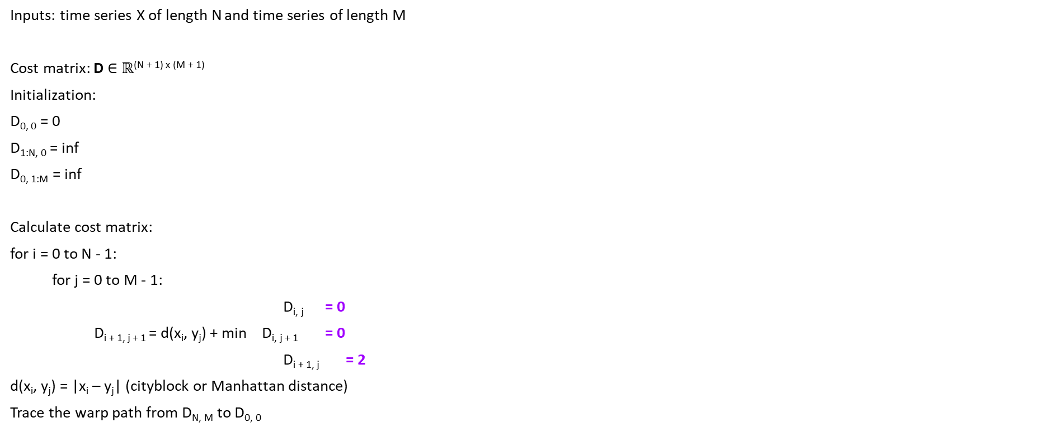
Dynamic Time Warping (DTW)
There’s an overlapping subproblem, DP to the rescue!
Inputs: time series X of length N and time series of length M
Cost matrix: D $∈$ $ℝ$^{(N + 1) x (M + 1)}
Initialization:
D_{0, 0} = 0
D_{1:N, 0} = inf
D_{0, 1:M} = inf
Calculate cost matrix:
for i = 0 to N - 1:
for j = 0 to M - 1:
D_{i, j} = 0
D_{i + 1, j + 1} = d(x_{i}, y_{j}) + min D_{i, j + 1} = 0
D_{i + 1, j} = 2
d(x_{i}, y_{j}) = |x_{i} – y_{j}| (cityblock or Manhattan distance)
Trace the warp path from D_{N, M} to D_{0, 0}
Time Series Y
 | 0 | 1 | 2 | 3 | 4 | 5 | 6 | 7
0 | 0 | inf | inf | inf | inf | inf | inf | inf
1 | inf | 0 | 0 | 0.5 | 2.5 | 2.5 | 3.5 | 3.5
2 | inf | 2 | 2
3 | inf
4 | inf
5 | inf
6 | inf
= 1
= 1
Time Series X
= 2

Slide 22
Dynamic Time Warping (DTW)
Finding Warp Path
Time Series Y
And always end here
 | 0 | 1 | 2 | 3 | 4 | 5 | 6 | 7
0 | 0 | inf | inf | inf | inf | inf | inf | inf
1 | inf | 0 | 0 | 0.5 | 2.5 | 2.5 | 3.5 | 3.5
2 | inf | 2 | 2 | 1.5 | 0.5 | 2.5 | 3.5 | 5.5
3 | inf | 2 | 2 | 2 | 2.5 | 0.5 | 1.5 | 1.5
4 | inf | 3 | 3 | 2.5 | 3 | 1.5 | 0.5 | 1.5
5 | inf | 3 | 3 | 3 | 4.5 | 1.5 | 1.5 | 0.5
6 | inf | 3 | 3 | 3.5 | 5 | 1.5 | 2.5 | 0.5
Time Series X
Find the warp path with optimal distance that starts from here

Slide 23
Dynamic Time Warping (DTW)
Finding Warp Path
Time Series Y
And always end here
 | 0 | 1 | 2 | 3 | 4 | 5 | 6 | 7
0 | 0 | inf | inf | inf | inf | inf | inf | inf
1 | inf | 0 | 0 | 0.5 | 2.5 | 2.5 | 3.5 | 3.5
2 | inf | 2 | 2 | 1.5 | 0.5 | 2.5 | 3.5 | 5.5
3 | inf | 2 | 2 | 2 | 2.5 | 0.5 | 1.5 | 1.5
4 | inf | 3 | 3 | 2.5 | 3 | 1.5 | 0.5 | 1.5
5 | inf | 3 | 3 | 3 | 4.5 | 1.5 | 1.5 | 0.5
6 | inf | 3 | 3 | 3.5 | 5 | 1.5 | 2.5 | 0.5
Time Series X
Find the warp path that starts from here

Slide 24
Dynamic Time Warping (DTW)
Finding Warp Path
Time Series Y
And always end here
 | 0 | 1 | 2 | 3 | 4 | 5 | 6 | 7
0 | 0 | inf | inf | inf | inf | inf | inf | inf
1 | inf | 0 | 0 | 0.5 | 2.5 | 2.5 | 3.5 | 3.5
2 | inf | 2 | 2 | 1.5 | 0.5 | 2.5 | 3.5 | 5.5
3 | inf | 2 | 2 | 2 | 2.5 | 0.5 | 1.5 | 1.5
4 | inf | 3 | 3 | 2.5 | 3 | 1.5 | 0.5 | 1.5
5 | inf | 3 | 3 | 3 | 4.5 | 1.5 | 1.5 | 0.5
6 | inf | 3 | 3 | 3.5 | 5 | 1.5 | 2.5 | 0.5
Time Series X
Find the warp path that starts from here

Slide 25
Dynamic Time Warping (DTW)
Finding Warp Path
Time Series Y
 | 0 | 1 | 2 | 3 | 4 | 5 | 6 | 7
0 | 0 | inf | inf | inf | inf | inf | inf | inf
1 | inf | 0 | 0 | 0.5 | 2.5 | 2.5 | 3.5 | 3.5
2 | inf | 2 | 2 | 1.5 | 0.5 | 2.5 | 3.5 | 5.5
3 | inf | 2 | 2 | 2 | 2.5 | 0.5 | 1.5 | 1.5
4 | inf | 3 | 3 | 2.5 | 3 | 1.5 | 0.5 | 1.5
5 | inf | 3 | 3 | 3 | 4.5 | 1.5 | 1.5 | 0.5
6 | inf | 3 | 3 | 3.5 | 5 | 1.5 | 2.5 | 0.5
Time Series X
The distance between time series X and time series Y
Warp path: ((1, 1), (1, 2), (1, 3), (2, 4), (3, 5), (4, 6), (5, 7), (6, 7))
Because our time series index starts from 0, let’s adjust: Warp path: ((0, 0), (0, 1), (0, 2), (1, 3), (2, 4), (3, 5), (4, 6), (5, 6))

Slide 26
Dynamic Time Warping (DTW)
Warp Path Interpretation
Warp path: ((0, 0), (0, 1), (0, 2), (1, 3), (2, 4), (3, 5), (4, 6), (5, 6))

Slide 27
Dynamic Time Warping (DTW)
Time Complexity
Inputs: time series X of length N and time series of length M
Cost matrix: D $∈$ $ℝ$^{(N + 1) x (M + 1)}
Initialization:
D_{0, 0} = 0
D_{1:N, 0} = inf
D_{0, 1:M} = inf
Calculate cost matrix:
for i = 0 to N - 1:
for j = 0 to M - 1:
D_{i, j}
D_{i + 1, j + 1} = d(x_{i}, y_{j}) + min D_{i, j + 1}
D_{i + 1, j}
d(x_{i}, y_{j}) = |x_{i} – y_{j}| (cityblock or Manhattan distance)
Trace the warp path from D_{N, M} to D_{0, 0}
Runs in O(N²)

Slide 28
The Sakoe-Chiba Band
Making DTW Faster 🧐
The Sakoe-Chiba band is defined through a radius parameter which determines the largest temporal shift allowed from the diagonal in the direction of the longest time series
DTW cost matrix with Sakoe-Chiba band of radius 1:
Time Series Y
 | 0 | 1 | 2 | 3 | 4 | 5 | 6 | 7
0 | 0 | inf | inf | inf | inf | inf | inf | inf
1 | inf |  |  |  | inf | inf | inf | inf
2 | inf |  |  |  |  | inf | inf | inf
3 | inf | inf |  |  |  |  | inf | inf
4 | inf | inf | inf |  |  |  |  | inf
5 | inf | inf | inf | inf
6 | inf | inf | inf | inf | inf
Time Series X

Slide 29
DTW with Sakoe-Chiba Band
Same Problem, Different Approach
Time Series Y
And always end here
 | 0 | 1 | 2 | 3 | 4 | 5 | 6 | 7
0 | 0 | inf | inf | inf | inf | inf | inf | inf
1 | inf | 0 | 0 | 0.5 | inf | inf | inf | inf
2 | inf | 2 | 2 | 1.5 | 0.5 | inf | inf | inf
3 | inf | inf | 2 | 2 | 2.5 | 0.5 | inf | inf
4 | inf | inf | inf | 2.5 | 3 | 1.5 | 0.5 | inf
5 | inf | inf | inf | inf | 4.5 | 1.5 | 1.5 | 0.5
6 | inf | inf | inf | inf | inf | 1.5 | 2.5 | 0.5
Time Series X
Find the warp path with optimal distance that starts from here

Slide 30
DTW vs DTW with Sakoe-Chiba Band
Comparison
Time Series Y
Time Series Y
 | 0 | 1 | 2 | 3 | 4 | 5 | 6 | 7
0 | 0 | inf | inf | inf | inf | inf | inf | inf
1 | inf | 0 | 0 | 0.5 | 2.5 | 2.5 | 3.5 | 3.5
2 | inf | 2 | 2 | 1.5 | 0.5 | 2.5 | 3.5 | 5.5
3 | inf | 2 | 2 | 2 | 2.5 | 0.5 | 1.5 | 1.5
4 | inf | 3 | 3 | 2.5 | 3 | 1.5 | 0.5 | 1.5
5 | inf | 3 | 3 | 3 | 4.5 | 1.5 | 1.5 | 0.5
6 | inf | 3 | 3 | 3.5 | 5 | 1.5 | 2.5 | 0.5
 | 0 | 1 | 2 | 3 | 4 | 5 | 6 | 7
0 | 0 | inf | inf | inf | inf | inf | inf | inf
1 | inf | 0 | 0 | 0.5 | inf | inf | inf | inf
2 | inf | 2 | 2 | 1.5 | 0.5 | inf | inf | inf
3 | inf | inf | 2 | 2 | 2.5 | 0.5 | inf | inf
4 | inf | inf | inf | 2.5 | 3 | 1.5 | 0.5 | inf
5 | inf | inf | inf | inf | 4.5 | 1.5 | 1.5 | 0.5
6 | inf | inf | inf | inf | inf | 1.5 | 2.5 | 0.5
Time Series X
Time Series X

Slide 31
DTW with Sakoe-Chiba Band
Drawbacks
Can lead to suboptimal distance and path if the radius is too small while the optimal warp path is far from diagonal
Although it is generally faster than DTW, the time complexity is still O(N²)

Slide 32
Fast DTW
Making DTW Even Faster 😎. Or Is It 😕?
An approximation of DTW that has a linear time O(N) and space complexity 😮
Uses a multilevel approach with three key operations:
Coarsening: Shrink a time series into a smaller time series that represents the same curve as accurately as possible with fewer data points
Projection: Find a minimum-distance warp path at a lower resolution, and use that warp path as an initial guess for a higher resolution’s minimum-distance warp path
Refinement: Refine the warp path projected from a lower resolution through local adjustments of the warp path

Slide 33
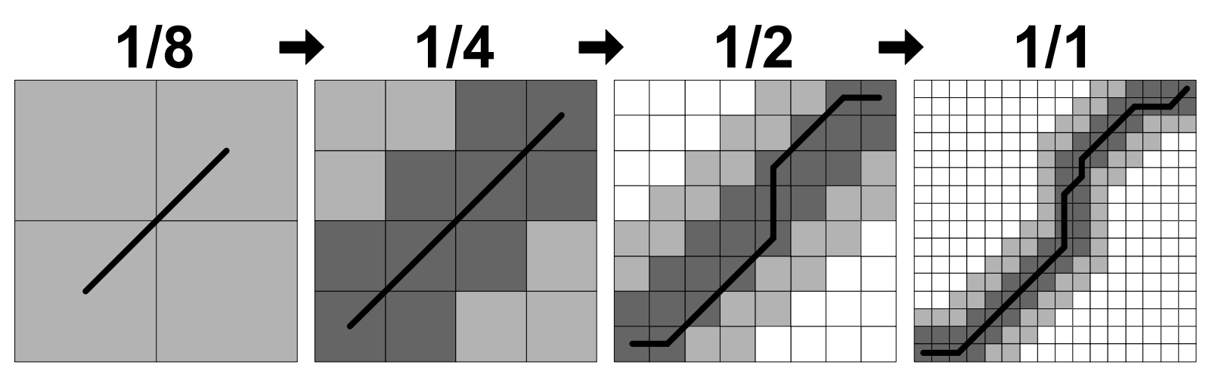
Fast DTW
Illustration

Slide 34
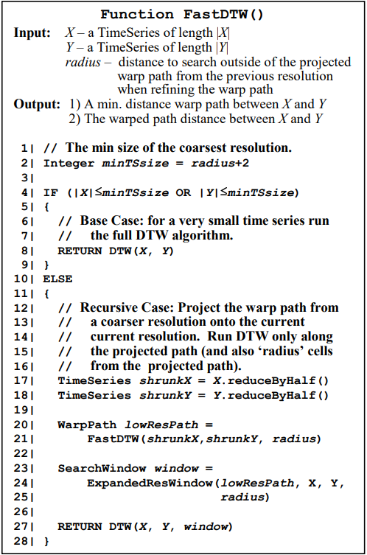
Fast DTW
Algorithm

Slide 35
Expanding Resolution Window
Create 2 x 2 blocks based on the path from lower resolution
Warp path from lower resolution

Slide 36
Expanding Resolution Window
Add 2 cells to the edges of 2 blocks if a diagonal move was performed
Warp path from lower resolution

Slide 37
Expanding Resolution Window
Add cells with width r to surround the expanded window
Warp path from lower resolution

Slide 38
Python Implementation
Using Only Numpy and Numba
Why Numba? Numba is an open source JIT compiler that translates a subset of Python and NumPy code into fast machine code
What’s this so called JIT compiler? JIT stands for just-in-time. The JIT compiler compiles the code during execution or at run time rather than before execution (ahead-of-time compilation like in C/C++)

Slide 39
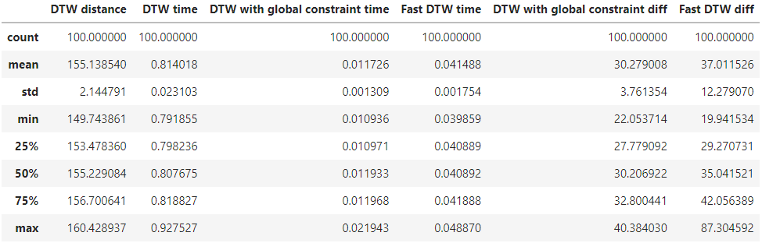
100 Runs Experiment Statistics
Finding The Distance and Path Between 2 Time Series of Length 1000 for 100 Times
Fast DTW runs slower than DTW with Sakoe-Chiba band
And not as accurate as DTW with Sakoe-Chiba band approximation!

Slide 40
Recap
DTW can be used to measure two time series, even with different lengths, and can identify which points correspond to one another in the two time series
The Sakoe-Chiba band is defined through a radius parameter which determines the largest temporal shift allowed from the diagonal in the direction of the longest time series
Both DTW and DTW with Sakoe-Chiba are polynomial time O(N²) algorithms
Fast DTW is an approximation of DTW that has a linear time O(N) and space complexity with 3 key operations: coarsening, projection, and refinement
Fast DTW generally runs faster than DTW, but slower than and not as accurate as DTW with Sakoe-Chiba band with the same radius

Slide 41
Thank You

